Slide 1
Introduction to .NET Bio

Slide 2
  Information in this document is subject to change without notice. The example companies, organizations, products, people, and events depicted herein are fictitious. No association with any real company, organization, product, person or event is intended or should be inferred. Complying with all applicable copyright laws is the responsibility of the user.
  Microsoft may have patents, patent applications, trademarked, copyrights, or other intellectual property rights covering subject matter in this document. Except as expressly provided in any license agreement from Microsoft, the furnishing of this document does not give you any license to these patents, trademarks, or other intellectual property.
  © 2011 Microsoft Corporation. All rights reserved.
  Microsoft, MS, Windows, MSDN, Visual Basic, Visual C++, Visual C#, and Visual Studio are either registered trademarks or trademarks of Microsoft Corporation in the U.S.A. and/or other countries.
  Other product and company names herein may be the trademarks of their respective owners.
Microsoft Biology Initiative Training by Microsoft Corporation is licensed under a Creative Commons Attribution 3.0 Unported License. Based on a work at research.microsoft.com/bio.

Slide 3
Agenda
Introduction to .NET Bio
  What is .NET Bio?
  Common usage scenarios
  Included tools

Slide 4

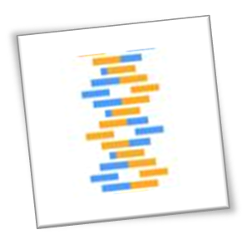
What is .NET Bio?
.NET Bio is a language-neutral bioinformatics toolkit
  built on top of the .NET Framework 4.0
  open source under Apache 2.0 license
  foundation upon which other tools can be built
Provides various components useful for biological analysis
  parsers to read and write common bioinformatics formats
  support for DNA, RNA and protein sequences
  algorithm framework for analysis and transformation
  web connector framework for web-service interaction

Slide 5
What is .NET Bio intended to do?
Primarily focused on genomics
  reusable data structures to represent sequences + symbols
  I/O framework to load/save sequences
  algorithm framework to process loaded sequences
Provides an alternative to other biology frameworks
  similar concepts to BioJava or BioPerl
  takes advantage of Microsoft developer tools and .NET
  will evolve as Microsoft and other contributors add features
Designed to manipulate large data sets
  efficient storage of data internally
  utilizes lazy loading techniques for creation of sequences
  scalable algorithms that take advantage of multiple cores

Slide 6
Tools supplied in .NET Bio
.NET Bio is comprised of two main elements
  set of basic tools and applications you can use for analysis
  framework to build additional, more complex tools on top of
Several command line tools supplied in \Bin\Tools directory
  ComparativeUtil
  SamUtils (BAM + SAM utilities)
  Several Alignment / Assembly utilities
  ReadSimulator
  Iron Python samples
  Workflow tools
  …
All tools have help page – invoke with "-h" to view
Full source code is provided in the \SDK directory

Slide 7
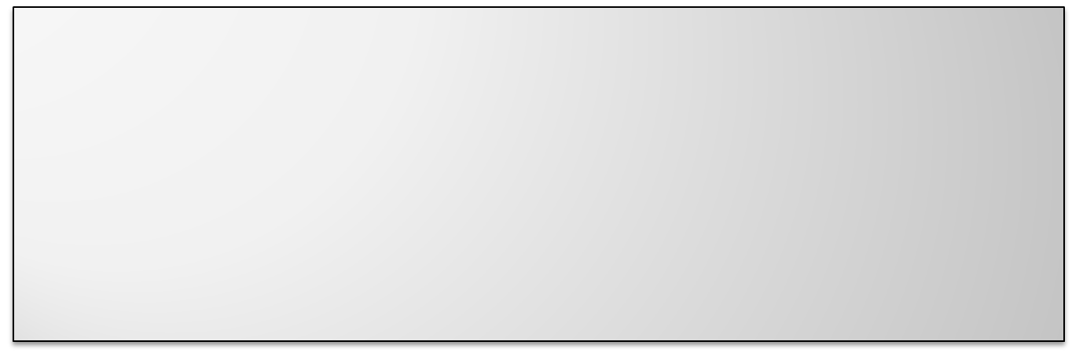
MumUtil – Maximal Unique Match
MumUtil finds unique matches between a reference file and one or more input files using MUMmer suffix trees
C:> mumutil -maxmatch -both -c -showMatchingString -noAmbiguity reference_sequence.fasta sequences.fasta
MumUtil v1.0 - Maximal Unique Match Utility
Copyright (c) 2011, The Outercurve Foundation.
...
> 00001::REFERENCE___Escherichia_coli::DIVIDER
1 1 213
4545454545454545454545454545454545454545458571676745454585454545454571714567717145676771856545716745
716745717185714545718545676745676567456785716545456767676765857...

Slide 8

NucmerUtil – multi alignment tool
NucmerUtil aligns multiple reference and query sequences
  uses MUMmer (primarily suited for large DNA sequences)
NucmerUtil.exe -r -f -v H_pylori_ref.fasta H_pylori_data.fasta
NUCmer Utility v1.0
Copyright (c) 2011, The Outercurve Foundation.
Processed Reference FastA file: H_pylori_ref.fasta
Read/Processing time: 00:00:00.0014443
File Size : 279242
Processed Query FastA file: H_pylori_data.fasta
Read/Processing time: 00:00:00.0000062
File Size : 268919
>
H_pyloriJ99_Eslice
TCACGCAACCAGACAATTTCAA ...

Slide 9

SAMUtils – SAM <-> BAM conversion
SAMUtils works with Sequence Alignment Map (SAM/BAM) files
  view (BAM)
  import (conversion)
  merge
  index
C:\>SAMUtils.exe view SeqAlignment.bam
read_28833_29006_6945 99 chr20 28833 20 10M1D25M = 28993 195 AGCT
TAGCTAGCTACCTATATCTTGGTCTTGGCCG <<<<<<<<<<<<<<<<<<<<<:<9/,&,22;;<<< NM:i:1 RG:Z:L1
read_28701_28881_323b 147 chr20 28834 30 35M = 28701 -168 ACCTATATCTTG
GCCTTGGCCGATGCGGCCTTGCA <<<<<;<<<<7;:<<<6;<<<<<<<<<<<<7<<<< MF:i:18 RG:Z:L2

Slide 10
ComparativeUtil – Sequence Assembly
ComparativeUtil performs comparative sequence assembly
  uses closely related sequence as reference
Combines several lower level tools
  MUMutil to generate comparison
  NucUtil to perform alignment
  LayoutRefinementUtil to refine layout
  RepeatResolutionUtil to unambiguously place reads
  ConcensusUtil to generate concensus
  ScaffoldUtil to put it all together

Slide 11
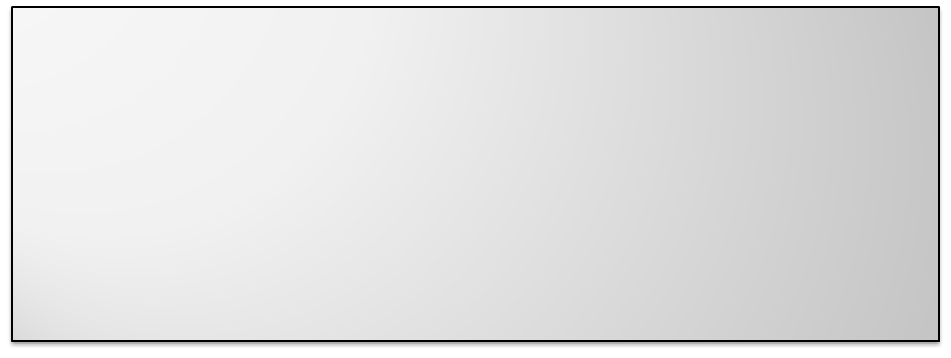
DeNovo Assembly
PadenaUtil supports high-performance DeNovo assembly
  can assemble, scaffold, or perform both together
PadenaUtil.exe Assemble data.fasta
TCGGGCCCGA
GTGCCATTGCCCCATGTGAAGTCACTGTGCCAGCCCAGAACACTGGTCTCGGGCC
GGCCCGAGAAGACCTCCTTTTTCCAGGCTTTAGGTATCACCACTAAAATCTCCAGGGGCACCATTGAAATCCTGAGTGATGTGCAGCTGATCAAGACTGG
AGACAAA
TCTCGGGCCCG

Slide 12
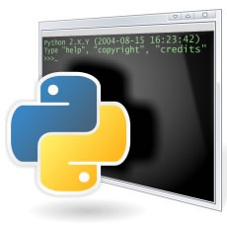
Scripting support
Samples directory includes IronPython examples
  show how to load FASTA and perform BLAST search
Can also use PowerShell for scripting support
  need to load appropriate assemblies (.NET)
  can then parse and manipulate sequences as objects
  provides a nice way to perform command-line style scripting
MSR also provides IronPython interactive console ShoRuntime
  includes Intel Math Kernel library for high-performance calculations
  download from http://research.microsoft.com/bio

Slide 13

ShoRuntime
ShoRuntime provides math and graphing using IronPython
  supports graph plotting (from array)
  supports statistics and high-performance match functions
Sho 2.0.4 on IronPython 2.6.1 (), .NET 4.0.30319.225 and MKL 10.3.
Includes parts of the Intel Math Kernel Library for Windows.
>>> ShoLoadAssembly(r"C:\Program Files (x86)\.NET Bio\1.0\Tools\Bin\Bio.dll")
<Assembly Bio, Version=1.0.4113.25400>
>>> import Bio
>>> sequences = Bio.IO.FastA.FastAParser("data.fasta").Parse()
>>> for s in sequences : print s.ID
ENA|BAD96188|BAD96188 (1)
ENA|BAD96188|BAD96188 (2)
...
ENA|BAD96188|BAD96188 (25)
ENA|BAD96188|BAD96188 (26)
ENA|BAD96188|BAD96188 (27)
>>>

Slide 14
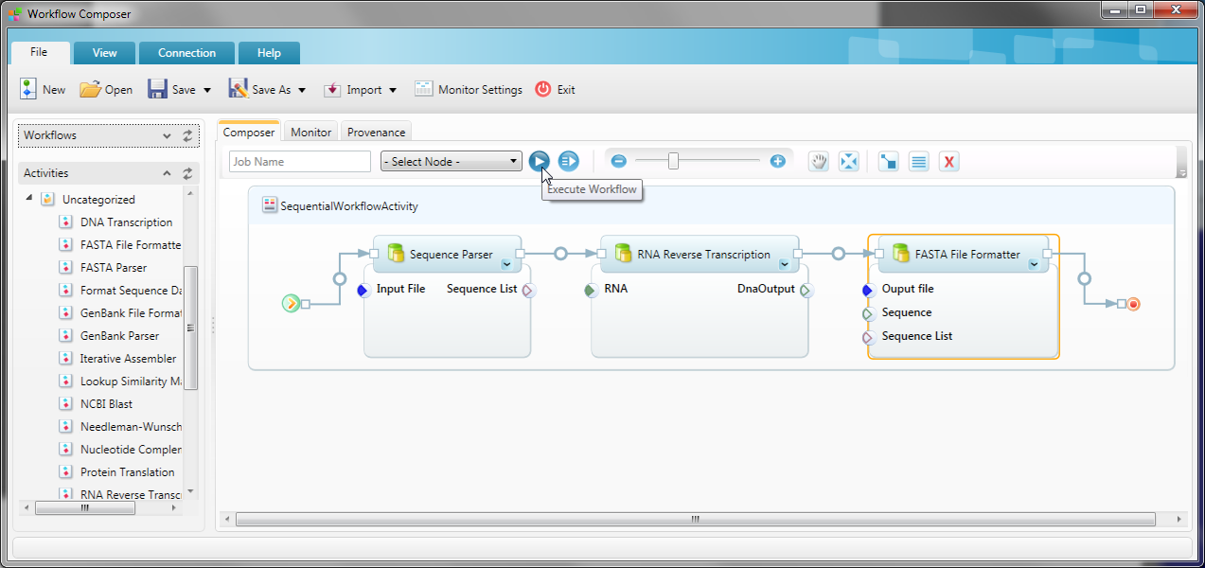
Trident Scientific Workflow Workbench
Trident provides set of tools built on Windows Workflow
  graphical analysis platform that creates and runs workflows
  http://tridentworkflow.codeplex.com
.NET Bio includes samples for integrating with Trident

Slide 15
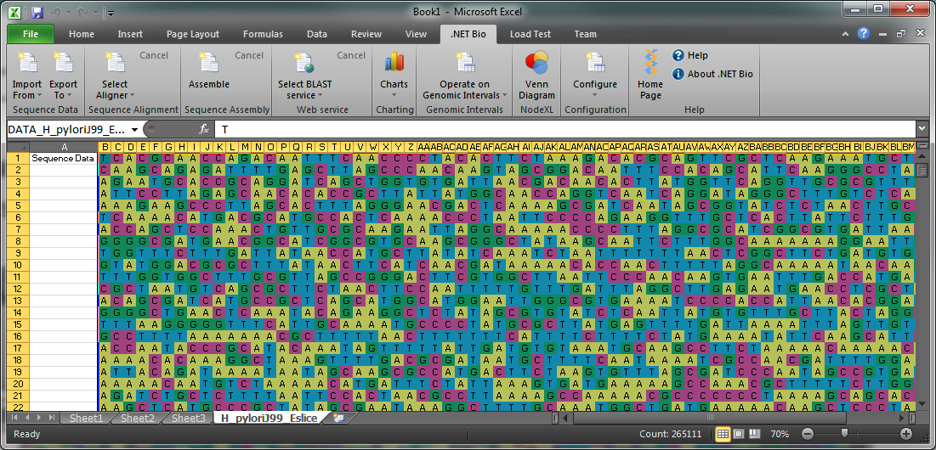
Excel add-in
Can parse and analyze sequences using Excel
  separate add-in installs toolbar into Excel^{[1]}
Notes:
[1] available from http://research.microsoft.com/bio
This also requires a free node display add-in called NodeXL (nodexl.codeplex.com)

Slide 16
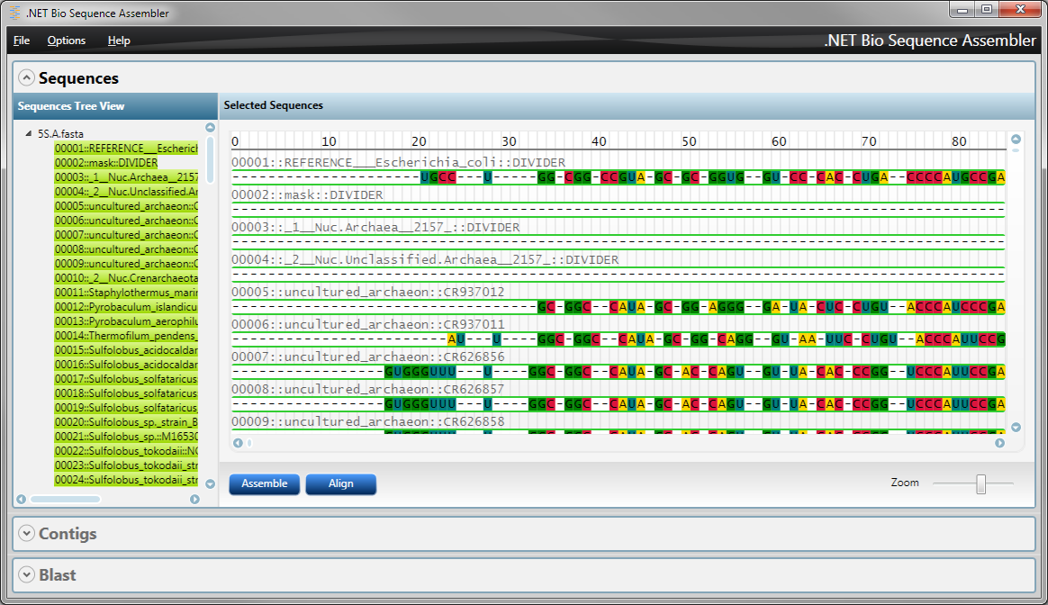
Sequence Assembler SDK sample
sequence data is loaded from FASTA file and assembled using .NET Bio
drawn as nucleotide symbols and graphics using WPF

Slide 17
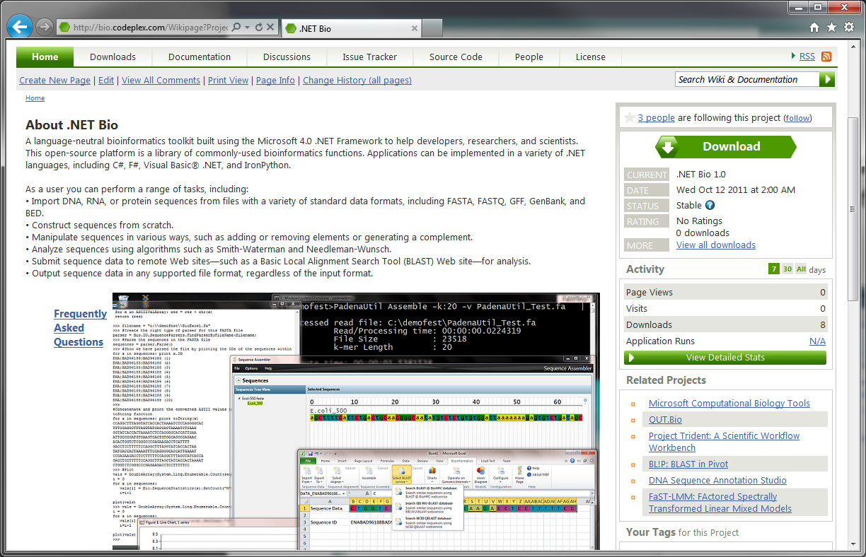
Getting .NET Bio
.NET Bio is available as an open source, free download
  http://bio.codeplex.com has source code and official releases

Slide 18
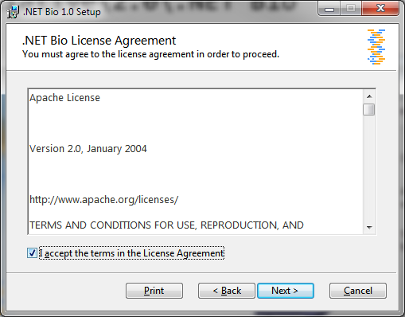
.NET Bio Licensing
.NET Bio is licensed under Apache
  http://www.apache.org/licenses/
  allows you to take the code and use it in academic or commercial products

Slide 19
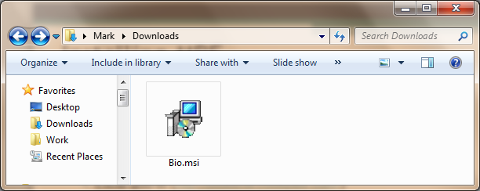
Installing .NET Bio
Official releases are packaged as Setup Files
  include all the pre-built assemblies you can use immediately
  installs full .NET 4.0 framework if not already installed
Several other tools available
  http://research.microsoft.com/en-us/projects/bio/mbt.aspx

Slide 20
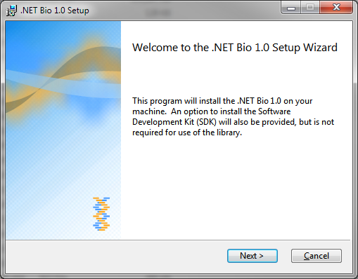
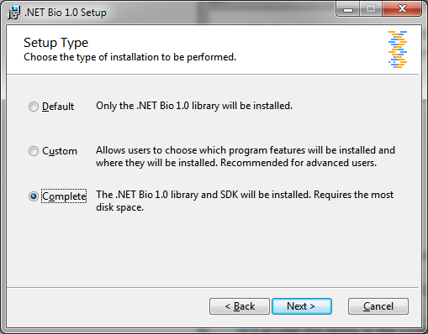

Installing .NET Bio
Run the Setup program to install the .NET Bio elements
  only supports Windows installs, other platforms require manual installation using source code
  creates %Program Files%\.NET Bio\1.0

Slide 21
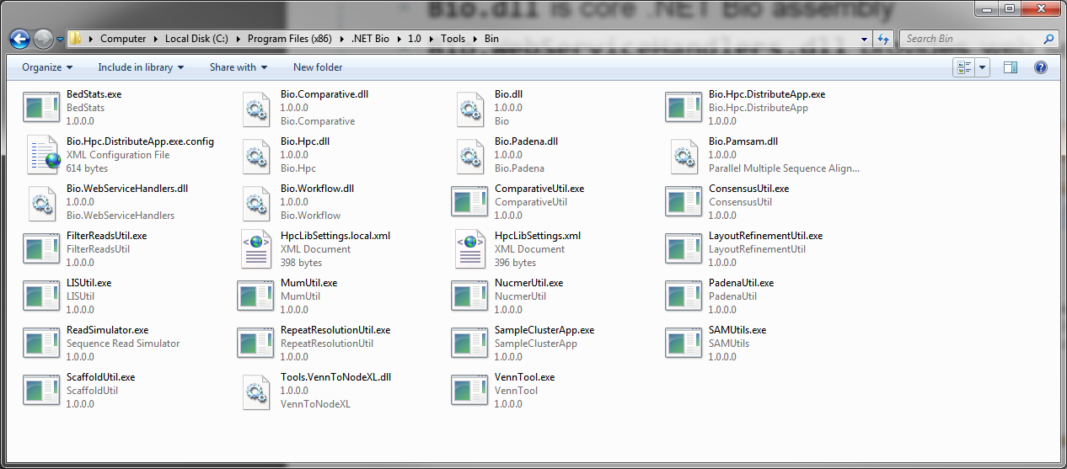
.NET Bio Installation
Installer creates several files and directories
  \Tools\Bin directory contains pre-built sample tools
  \SDK directory contains samples and additional documentation
  Bio.dll is core .NET Bio assembly

Slide 22
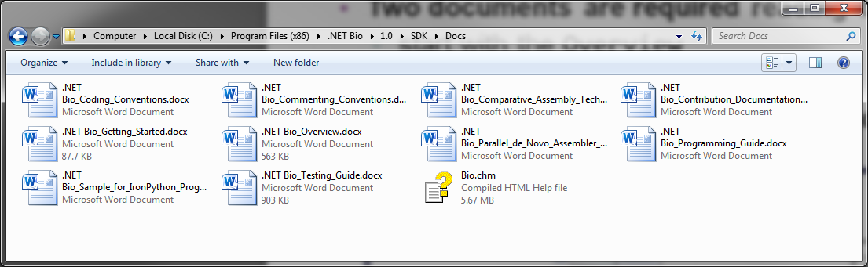
Documentation
Several documents supplied with installation
  included with full install in \SDK\Docs directory
  also available from http://bio.codeplex.com/documentation
Two documents are required reading before you begin
  start with the Overview and Getting_Started documents
  then read the Programming_Guide
Bio.chm help file provides API reference

Slide 23
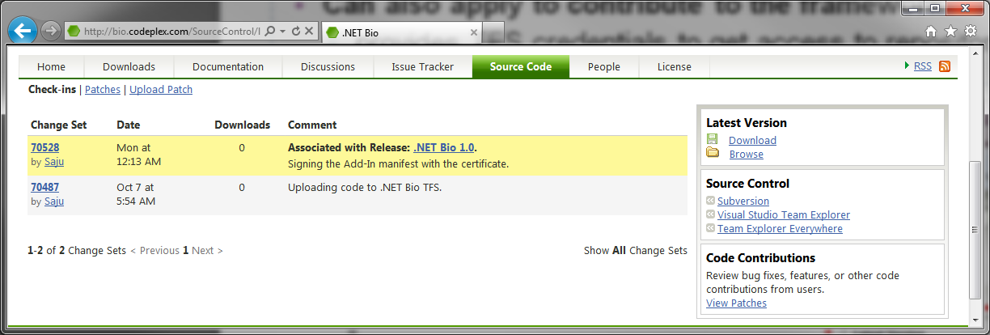
Download the source code
Source code is available online at CodePlex
  can download as a pre-packaged .ZIP file^{[1]}
Can also apply to contribute to the framework
  provides TFS credentials to get access to repository
Notes:
[1] Click on the Source Code tab of the Codeplex site – here you will find each checked-in change set. You can browse the source online, or download the set as a whole by clicking the Download button on the right side. It comes packaged as a .zip file and includes the entire buildable tree.

Slide 24
Summary
.NET Bio framework is used to build bioinformatics applications
  open source
  highly extensible
  scalable
  flexible data architecture

Slide 25
  Disclaimer: This document is provided "as-is". Information and views expressed in this document, including URL and other Internet Web site references, may change without notice. You bear the risk of using it.
  This document does not provide you with any legal rights to any intellectual property in any Microsoft product. You may copy and use this document for your internal, reference purposes.
  © 2011 Microsoft Corporation. All rights reserved.
  Microsoft, Visual Studio, and Windows are trademarks of the Microsoft group of companies. All other trademarks are property of their respective owners.

